Slide 1
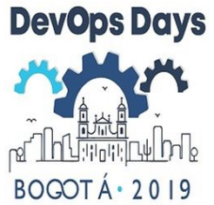
Digital Transformation @ ROSEN

Slide 2

What Is Digital Transformation – More than technology
Software Ecosystems
Augmented Reality
Software as a Service
Shared Economy
Virtual Reality
Machine Learning
Deep Learning
Online Shops
Social Marketing
Digital Twin
Digital Transformation
Drones
Big Data Analytics
Blockchain
Internet of Things
Chatbots
Robotics
Platform
Cloud Computing
Industry 4.0
Artificial Intelligence
Platform Business Models
On-demand Service Platforms
Marketplaces
Content Crowdsourcing Platforms
And many more…

Slide 3
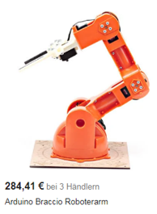



Technologies are already Available …and affordable

Slide 4

The question is…
Available & Affordable!
?
BUT…
How to apply up-to-date digital technologies in business
How do digital technologies influence business
What is our approach @ ROSEN
What are the key challenges

Slide 5


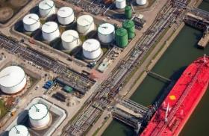
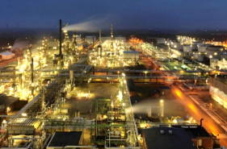
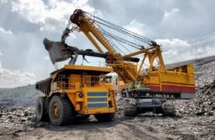



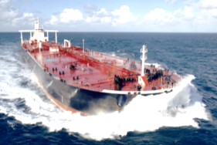

Our Business
ROSEN develops and manufactures equipment, software and methods for the inspection, diagnosis and protection of industrial structures in a wide range of industries.

Slide 6
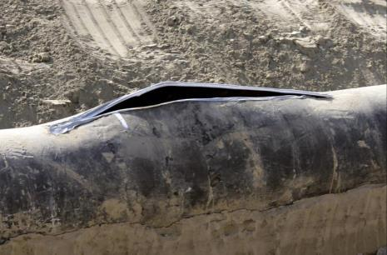
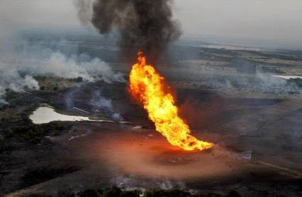
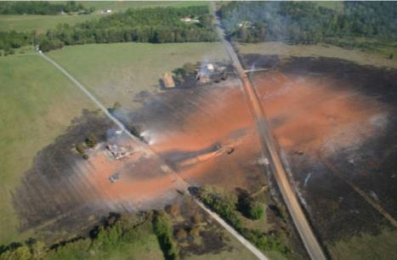
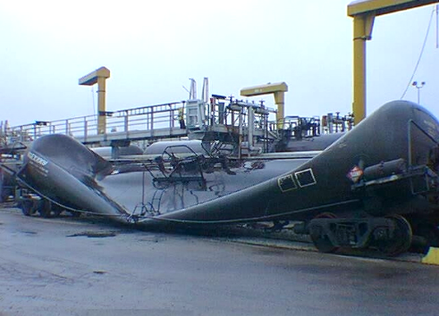

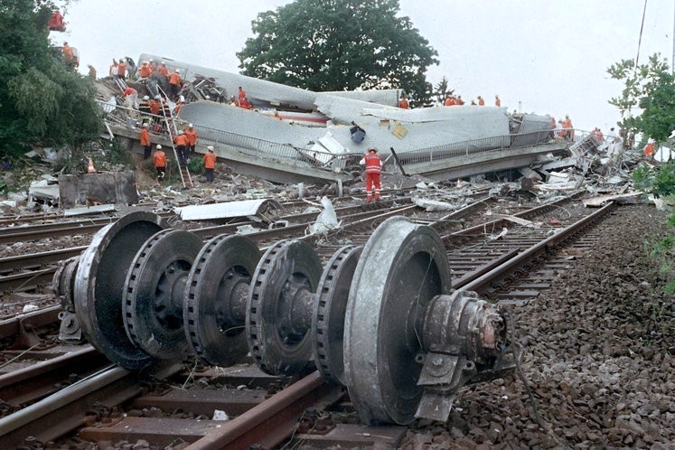
oUr market - safety
This damage can cause serious impacts:

Slide 7
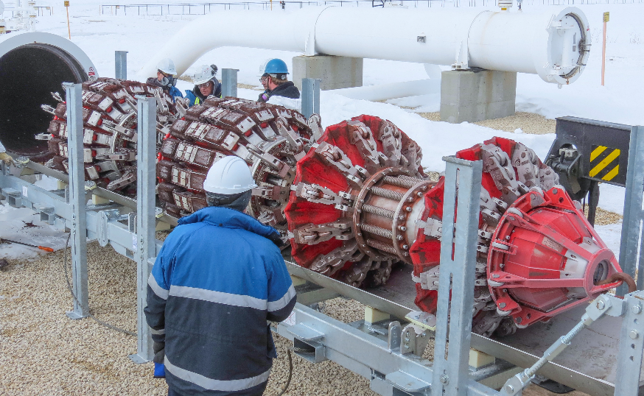

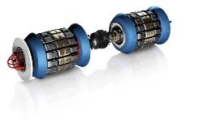
Asset – Data – Information - Decisions
Customer
Customer
Data
Preparation
Data
Analyze
Information Reporting
Assessments
Sensor Data
Device Data
Raw Data
Analyze Information
Diagnostic
Report Results
Integrity Results
Up to TBytes of data per pipeline inspection
Up to several GB

Slide 8
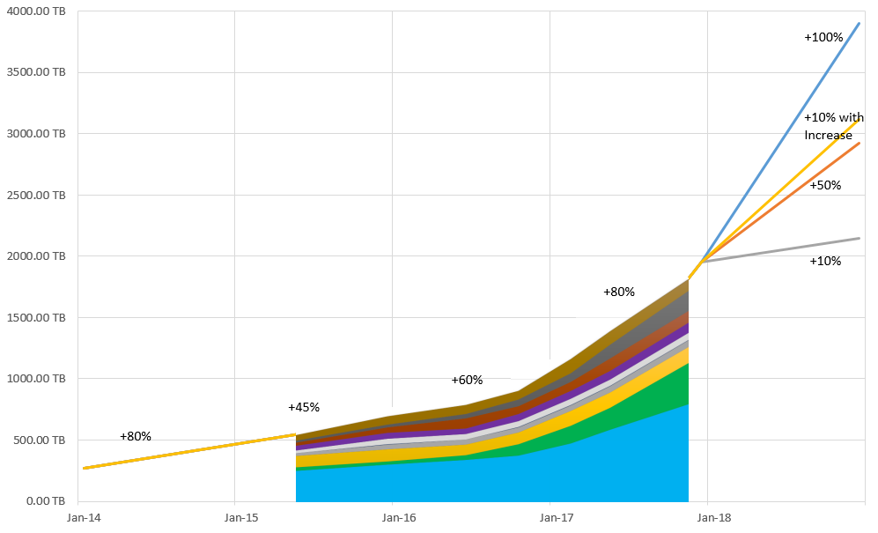
Amount of Data

Slide 9
Efficiency and Effectiveness are Key
Customer
Customer
Data
Preparation
Data
Analyze
Information Reporting
Assessments
Sensor Data
Device Data
Raw Data
Analyze Information
Diagnostic
Report Results
Integrity Results
Up to TBytes of data per pipeline inspection
Up to several GB
How can DevOps and up-to-date digital technologies help to be more effective and more efficient?
And why is that not so easy as it sometimes seems to be?

Slide 10
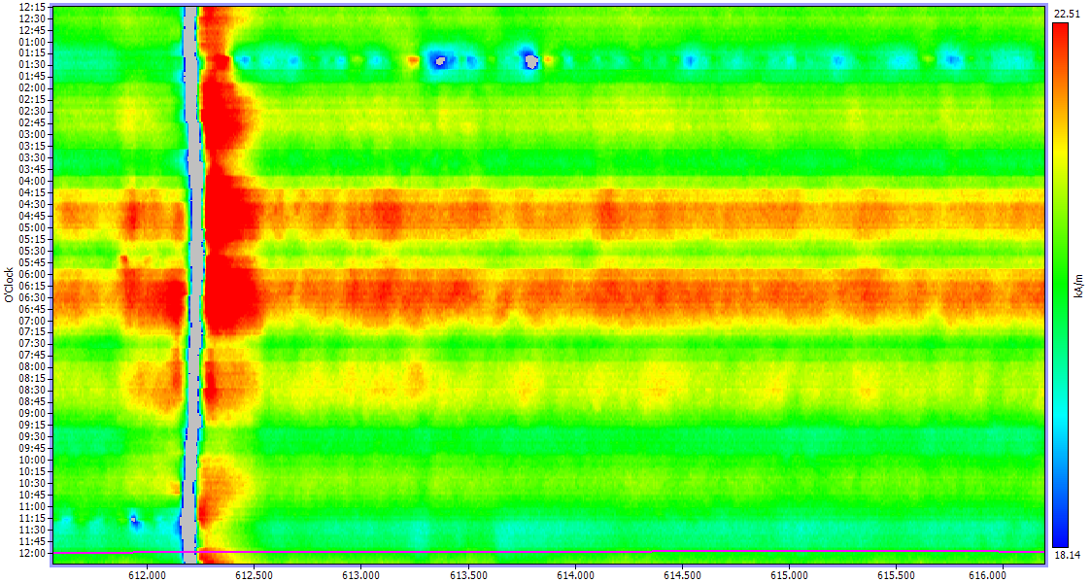
Challenge: Classification and Interpretation of Sensor Data

Slide 11
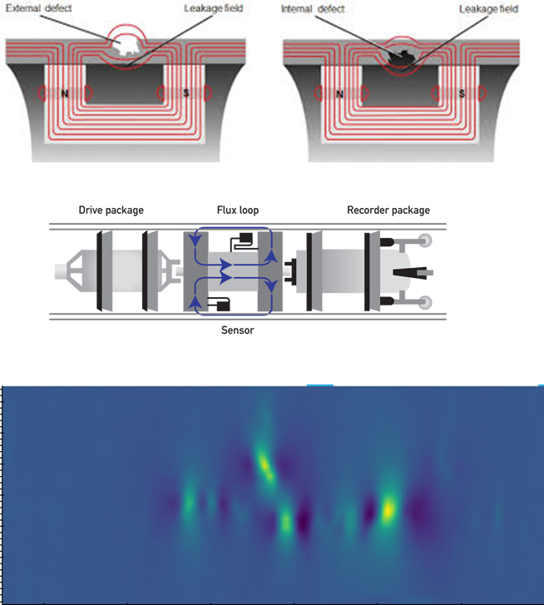
Example: MACHINE lEARNING
Classification of installations and anomalies and accurate estimation of severity of defects.
Severe defects threaten the integrity of the pipelines, therefore there is a high risk for environment and clients.
We address these challenges with machine learning.

Slide 12
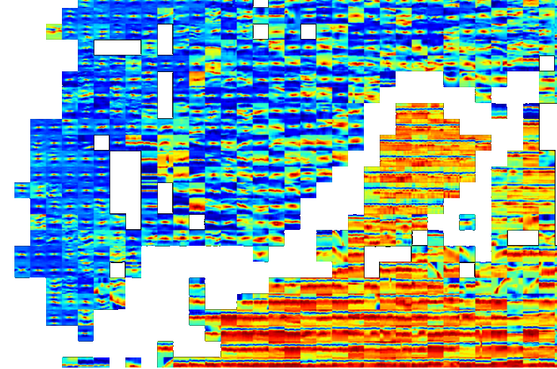
Classification with Machine Learning
Decision trees (XGBoost, CatBoost)
(Unsupervised) Embeddings (PCA, t-SNE, UMAP)
Active Learning
Convolutional Neural Networks
Pulltest Data
Field Data
Synthetic Data
GoDocker Cluster with 500 Nodes
Compute Clusters
Several GPUs (Tesla V100, P100, M60)

Slide 13
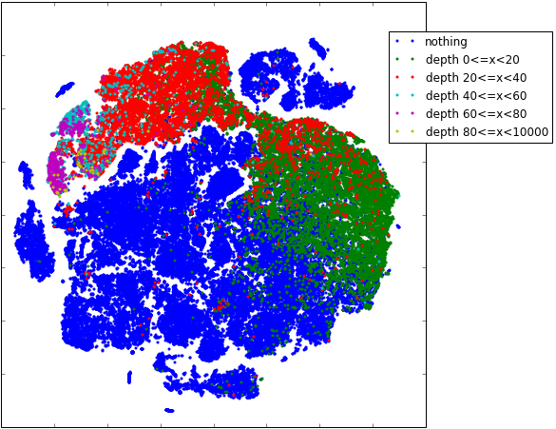
Classification with Machine Learning
Color shows depths of defects
70,000 data points

Slide 14
Any Challenges left?
So…recipe for digital transformation:
Take the data
Apply latest digital technologies (like machine learning algorithms)
Deliver results to customer
And that’s it…!??

Slide 15
Data Quality is Key
Completeness
Availability
Consistency
Data Quality
Integrity
Conformity
Accuracy
Notes:
Completeness: Defined as expected comprehensiveness; Data can be considered as complete as long as it meets the expectations
Consistency: Means: data across all systems reflects the same information and are in synch with each other across the company
Conformity: Data is following the set of standard data definitions like data type, size and format (e.g. “mm/dd/yyyy”)
Accuracy: Degree to which data correctly reflects the real world object or an event being described
Integrity: Validity of data across the relationships and ensures that all data in a database can be traced and connected to other data.
Availability: Information is available when it is expected and needed; Depends on user expectation.

Slide 16
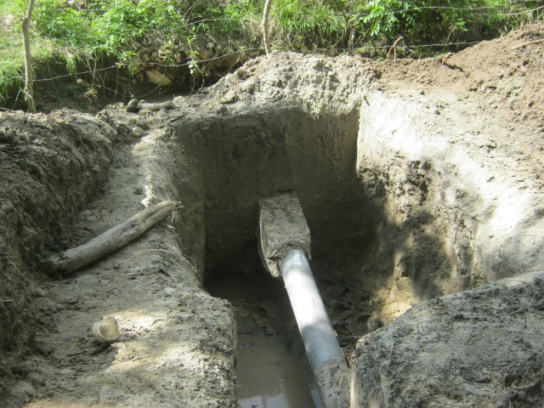
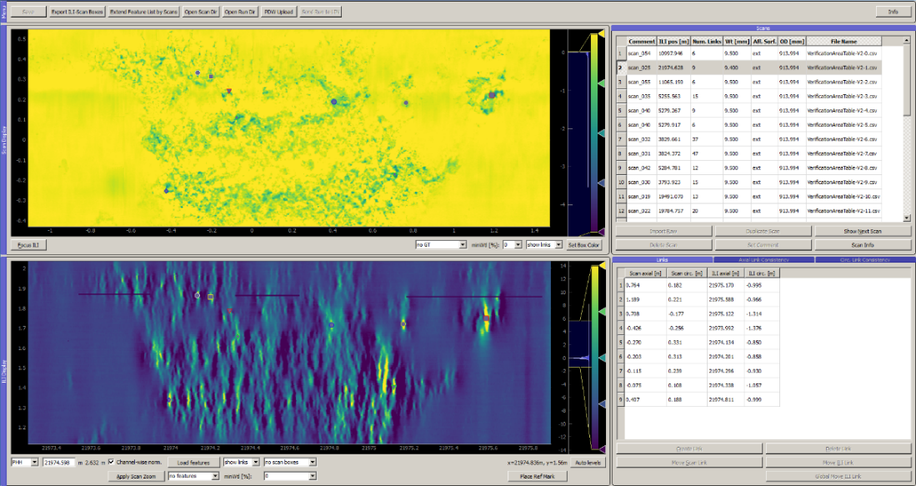

Our ground truth – Field verifications
Pipelines need to be dug up to get access to ground truth
Defect geometry can be measured using 3d laser scanners
Alignment to NDT data and labeling by hand

Slide 17



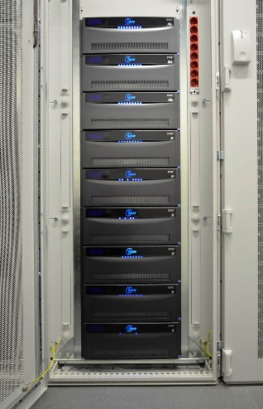
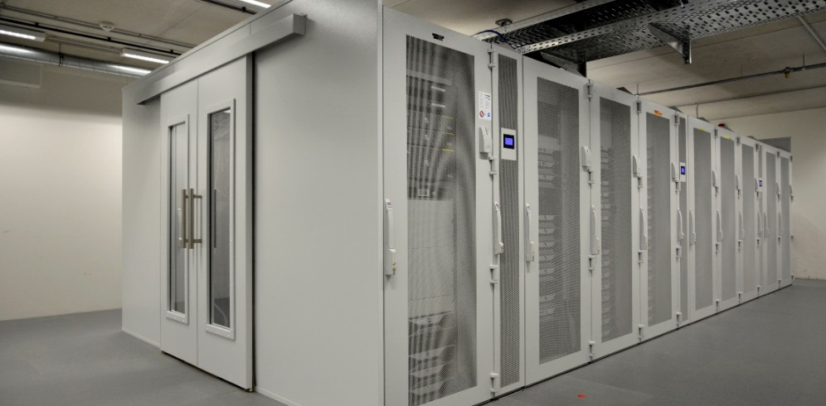
Data Standardization
Clients use different data formats
Flexible converter tools
CSV or HDF5 as data container
MongoDB for the meta data
Proper interfaces for data access
Data storage
IT-support

Slide 18


Applied Research vs Development
TASK: DEVELOPMENT
Products and services for the current market demand
TechnologyPlatform
Application Platform
Development & Operations, incl.
Testing
Usability
Architecture
Frontend / Backend / Business Logic
Security
Maintenance
Performance optimization
…
TASK: APPLIED RESEARCH
Technologies for the future market demand

Slide 19
Challenges in bringing Development & Operations together?
Development
Operations
Testing
Usability
Architecture
Frontend/Backend
Security
Maintenance
Performance optimization
…
Infrastructure
Virtual Machines
Network
Storage
Firewalls
Policies
Deployment
Hotline
…
Regular meetings and workshops
Involvement of Operations right from the beginning of a dev project
…

Slide 20
Beyond DevOps
Finance
Business
Development
“It’s important to remind that in a digital transformation (and, for that matter digital business) context, all aspects, functions, processes, etc. are interconnected and silos have less (or no) place, not from a technological perspective but most of all also not from a process and people perspective.”
Legal & Compliance
Operations
Marketing

Slide 21
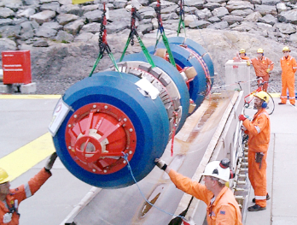

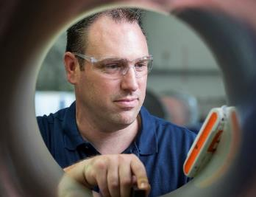

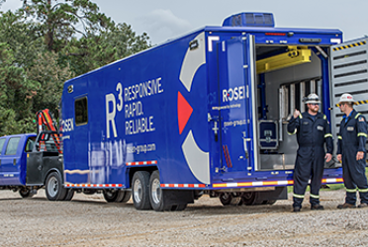
Classical Business Approach
Customer
Customer
Customer
Customer
Customer
Diagnostic Solutions
Integrity Solutions
Intelligent Plastic Solutions
Flow Metering Solutions
…
Projects & SW Solutions
Projects & SW Solutions
Projects & SW Solutions
Projects & SW Solutions
Projects & SW Solutions

Slide 22


Platform Approach @ ROSEN
Internet
Asset Integrity
ECO Platform
Process Optimization
ECO Platform
external
Goal:
Most safe, economical and reliable Assets
(Effectiveness)
Goal:
Most productive and secure Processes
(Efficiency)
Business Field Asset Integrity
Business Field
Process Optimization
Application Software
Platform
Business Software
Platform
internal
Intranet

Slide 23
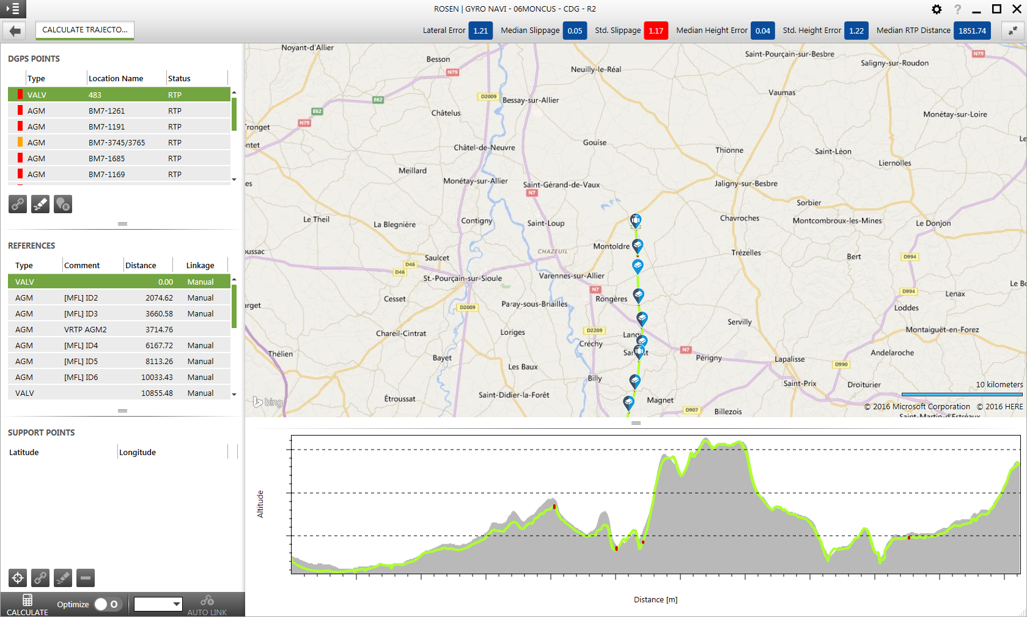
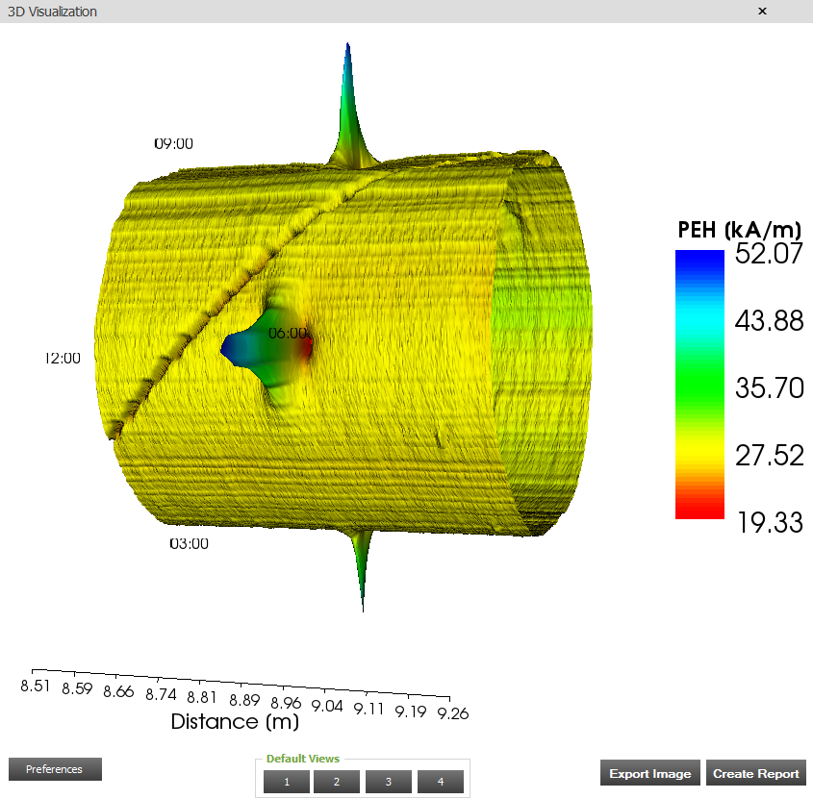
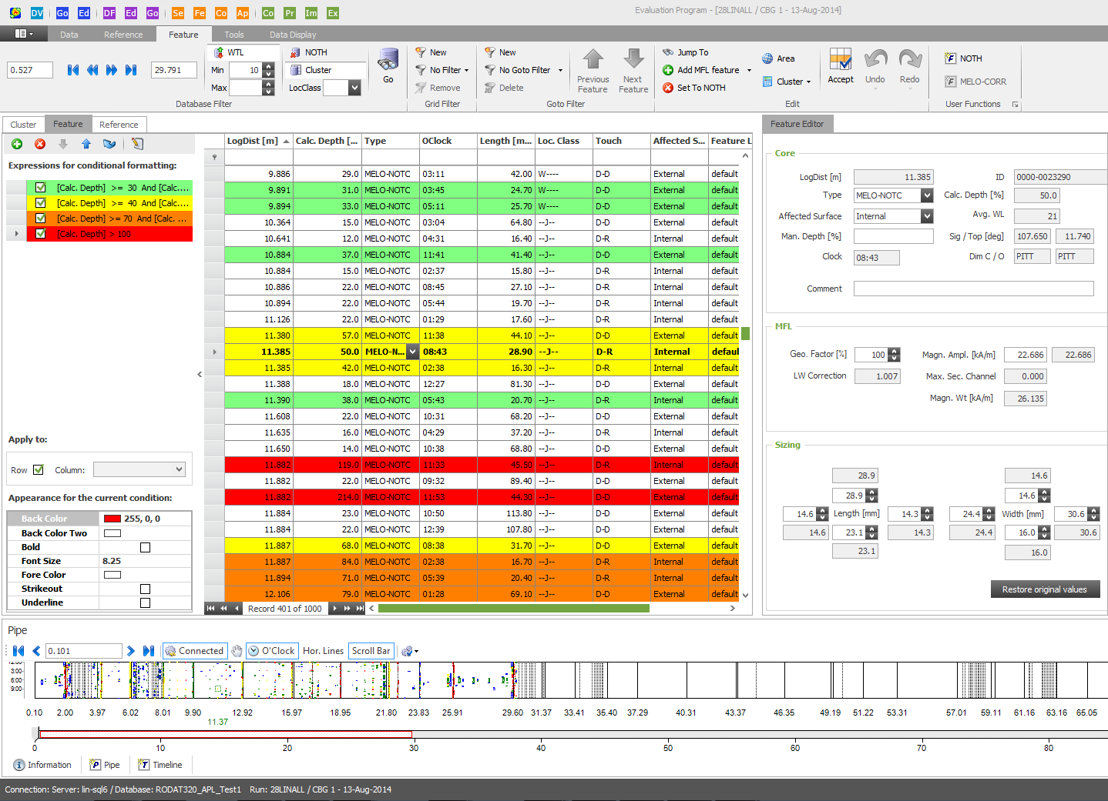
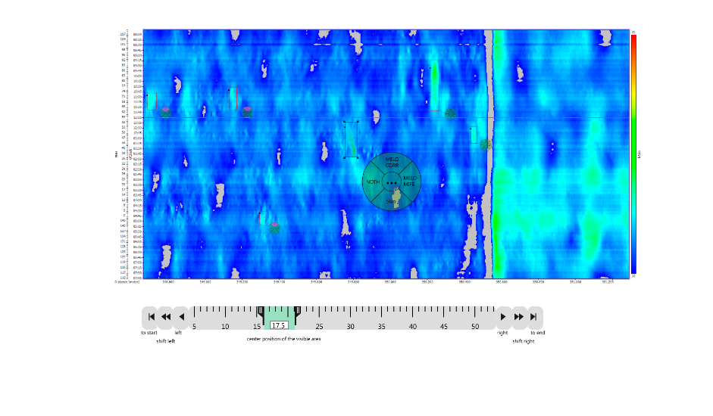
Our Application Software > 100 Applications

Slide 24
Platform Business Approach
Challenges regarding DevOps?
- a lot!
Customers & other platform participants
Asset Integrity ECO Platform
Diagnostic Solutions
Integrity Solutions
Intelligent Plastic Solutions
Flow Metering Solutions
…
Projects & SW Solutions
Projects & SW Solutions
Projects & SW Solutions
Projects & SW Solutions
Projects & SW Solutions

Slide 25

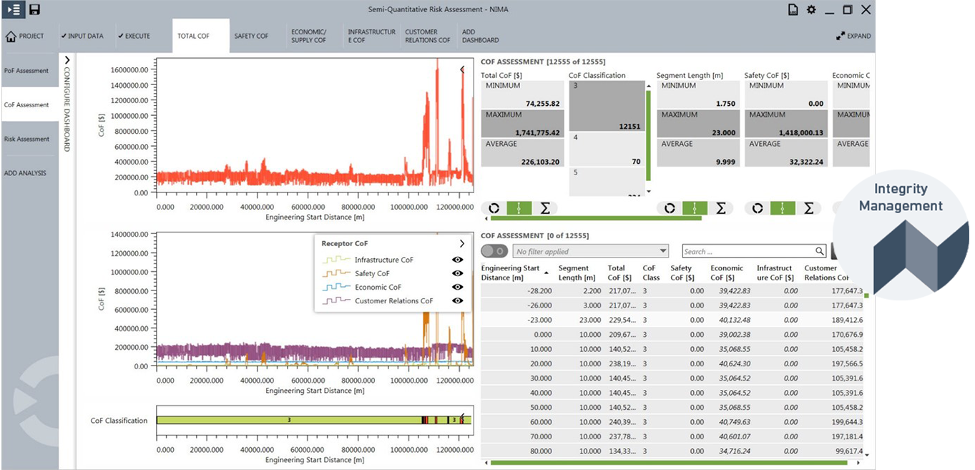
Platform Example

